Slide 1
An Introduction to UNIX
Notes:
Intro me and what I do – DCS UKDC

Slide 2
Agenda
A Introduction to Unix
Logging into Unix
Understanding Unix Users and Groups
Unix Directory Structure
Permissions and settings
Commands and other utilities
Editors
Process and Daemons
Confidential: For Internal Use Only. Copyright © 2011 Accenture. All Rights Reserved.

Slide 3
What is Unix
Unix is an operating system
  Handles files, running other programs, input/output
  Kernel is the core of the Unix OS.
  Looks like DOS but it is more powerful
  Various variants of Unix available in Market.
Multi-user, Multitasking
  Every user has different settings and permissions
  Multiple users can be logged in simultaneously
Confidential: For Internal Use Only. Copyright © 2011 Accenture. All Rights Reserved.

Slide 4
History
Dennis Ritchie & Kenneth Thompson created it
  At AT&T Bell labs in 1969
  Written in “C” language
  Started developing with innovative time-sharing OS called Multics
  In 1972 Unix was rewritten in the C programming language
  In 1990, Unix-like systems grew in popularity as Linux.
  Unix OS are widely used in modern servers and workstations.
Confidential: For Internal Use Only. Copyright © 2011 Accenture. All Rights Reserved.

Slide 5
Unix Vs Linux
Unix
It is an operating system that is very popular in universities, companies, big enterprises etc.
It comes with various file systems such as jfs, gpfs (AIX), jfs, gpfs (HP-UX), jfs, gpfs (Solaris).
The UNIX operating system is used in internet servers, workstations & PCs
Linux
Linux is an example of Open Source software development and Free Operating System (OS).
Linux by default supports and use ext3 or ext4 file systems.
Linux can be installed on a wide variety of computer hardware, ranging from mobile phones, tablet computers and to mainframes and supercomputers.
Confidential: For Internal Use Only. Copyright © 2011 Accenture. All Rights Reserved.

Slide 6
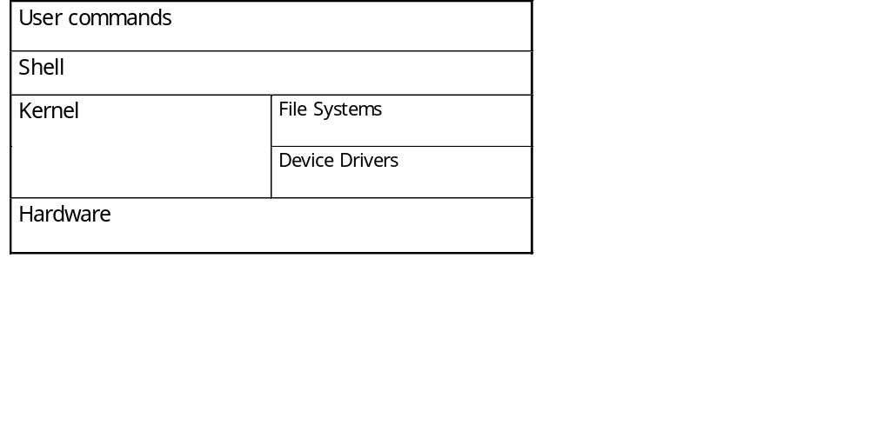
The Unix System architecture
User commands includes executable programs and scripts
The shell interprets user commands. It is responsible for finding the commands and starting their execution. Several different shells are available. Bash is popular,
The kernel manages the hardware resources for the rest of the system.
Confidential: For Internal Use Only. Copyright © 2011 Accenture. All Rights Reserved.

Slide 7
Login unix
When you first connect to a UNIX system, you usually see a prompt such as the following
Have your userid (user identification) and password ready. Contact your system administrator if you don't have these yet.
Type your userid at the login prompt, then press ENTER. Your userid is case-sensitive, so be sure you type it exactly as your system administrator instructed.
Type your password at the password prompt, then press ENTER. Your password is also case-sensitive.
Confidential: For Internal Use Only. Copyright © 2011 Accenture. All Rights Reserved.

Slide 8
Logging In
Before you can use it you must login by specifying your account and password:
login as: testuser
testuser@10.35.1.152's password:
Last login: Tue Aug 11 05:11:15 2015 from 10.35.2.178
Confidential: For Internal Use Only. Copyright © 2011 Accenture. All Rights Reserved.

Slide 9
Startup file
When you login to Unix, some commands are executed automatically and the environment is set for you. (eg. Setting of variable that controls the behavior of shell).
System startup file
The system startup file is used for tasks that are common to all system users. Examples of these tasks are setting your time zone (TZ), and the global search path for extrinsic commands (etc/profile)
User startup file
The user startup file is called .profile ("dot profile") and is placed in a user's home directory. This file is used for user-specific tasks, such as setting shell aliases, and for executing any programs that a user wants to start soon after login
Confidential: For Internal Use Only. Copyright © 2011 Accenture. All Rights Reserved.

Slide 10
Rule Number 1
Do not login as root unless you have to
root is the system superuser (the “maint” of Unix but more “dangerous”)
  Careless use can cause damage
  Has access to everything by default
root is the only user defined when you install
  First thing is to change root’s password
  The second job is to define “normal” users for everyday use
Confidential: For Internal Use Only. Copyright © 2011 Accenture. All Rights Reserved.

Slide 11
Creating a new user
Use the useradd command
Use the passwd command to set password
Try it… logon as root
[root@penguinvm]# useradd testuser1
[root@penguinvm]# passwd testuser1
Changing password for user testuser1
New UNIX password:
Retype new UNIX password:
passwd: all authentication tokens updated successfully
[root@penguinvm]#
Confidential: For Internal Use Only. Copyright © 2011 Accenture. All Rights Reserved.

Slide 12
Users and Groups
Users are identified by user identifications (UIDs), each of which is associated with an integer in the range of 0 to 4 294 967 295. Users with UID=0 are given superuser privileges.
Users are placed in groups, identified by group identifications (GIDs). Each GID is associated with an integer in the range from 0 to 4 294 967 295
Let the system assign UID to avoid duplicates
Use id to display your user and group information
uid=500(neale) gid=500(neale) groups=500(neale),3(sys),4(adm)
Confidential: For Internal Use Only. Copyright © 2011 Accenture. All Rights Reserved.

Slide 13
Users and Groups
Groups define functional areas/responsibilities
They allow a collection of users to share files
A user can belong to multiple groups
You can see what groups you belong to using the groups command:
neale sys adm
Confidential: For Internal Use Only. Copyright © 2011 Accenture. All Rights Reserved.

Slide 14
Using the new user
Now logoff using the exit command
login as the new user
login as: testuser1
testuser1@x.x.x.x's password:
Last login: Tue Aug 11 05:11:15 2015 from x.x.x.x
Confidential: For Internal Use Only. Copyright © 2011 Accenture. All Rights Reserved.

Slide 15
Extrinsic and Intrinsic Commands
Commands that a user issues are intrinsic commands( Ex: cd
Other commands are stored as a separate files are called extrinsic commands. Ex: ls
Shell initially checks if it is an intrinsic commands otherwise extrinsic commands are checked.
Confidential: For Internal Use Only. Copyright © 2011 Accenture. All Rights Reserved.

Slide 16
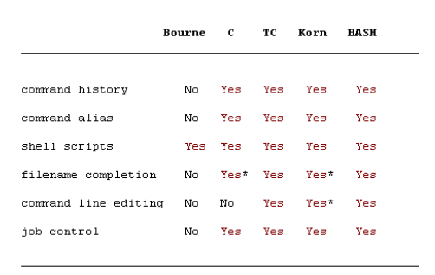
Types of Unix Shells
Bourne Shell -- /bin/sh To change your shell use
C shell -- /bin/csh command chsh –s /bin/sh
Korn Shell - /bin/ksh
Bash Shell - /bin/bash
TC Shell - /bin/tcsh
Confidential: For Internal Use Only. Copyright © 2011 Accenture. All Rights Reserved.

Slide 17
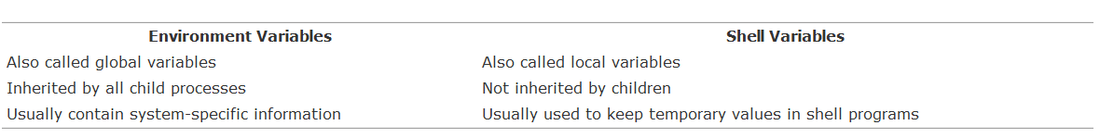
Environment variables and Shell variables
When a shell executes a command, UNIX create a process in memory for that command. This process is called the Child process.
The shell created this process hence it is called as parent process of the command process.
Confidential: For Internal Use Only. Copyright © 2011 Accenture. All Rights Reserved.

Slide 18
Environment Variables
Using Environment Variables:
  echo $VAR
  cd $VAR
  cd $HOME
  echo “You are running on $SYSTEMNAME”
Displaying - use the following commands:
  set (displays local & env. Vars)
  export
Vars can be retrieved by a script or a program
Confidential: For Internal Use Only. Copyright © 2011 Accenture. All Rights Reserved.

Slide 19
Some Important Environment Variables
HOME
  Your home directory (often be abbreviated as “~”)
TERM
  The type of terminal you are running (for example vt100, xterm, and ansi)
PWD
  Current working directory
PATH
  List of directories to search for commands
Confidential: For Internal Use Only. Copyright © 2011 Accenture. All Rights Reserved.

Slide 20
PATH Environment Variable
Controls where commands are found
  PATH is a list of directory pathnames separated by colons. For example:
  PATH=/bin:/usr/bin:/usr/X11R6/bin:/usr/local/bin:/home/scully/bin
  If a command does not contain a slash, the shell tries finding the command in each directory in PATH. The first match is the command that will run
Confidential: For Internal Use Only. Copyright © 2011 Accenture. All Rights Reserved.

Slide 21
You need help?
The Unix equivalent of HELP is man (manual)
  Use man -k <keyword> to find all commands with that keyword
  Use man <command> to display help for that command
    Output is presented a page at a time. Use b for to scroll backward, f or a space to scroll forward and q to quit
Confidential: For Internal Use Only. Copyright © 2011 Accenture. All Rights Reserved.

Slide 22
Unix File System Basics
Directories
/
root
Unix files are stored in a single rooted, hierarchical file system
  Data files are stored in directories (folders)
  Directories may be nested as deep as needed
etc
home
usr
passwd
inittab
User home directories
neale
scully
marty
a
b
Data files
Confidential: For Internal Use Only. Copyright © 2011 Accenture. All Rights Reserved.

Slide 23
Naming Files
Files are named by
  naming each containing directory
  starting at the root
This is known as the pathname
/
etc
home
usr
passwd
inittab
/etc/passwd
neale
scully
marty
a
b
/home/neale/b
Confidential: For Internal Use Only. Copyright © 2011 Accenture. All Rights Reserved.

Slide 24
The Current Directory
One directory is designated the current working directory
  if you omit the leading / then path name is relative to the current working directory
  Use pwd to find out where you are
/
etc
home
usr
passwd
inittab
neale
scully
marty
Current working directory
a
doc
doc/letter
./doc/letter
/home/neale/doc/letter
Confidential: For Internal Use Only. Copyright © 2011 Accenture. All Rights Reserved.
letter

Slide 25
Some Special File Names
Some file names are special:
  / The root directory (not to be confused with the root user)
  . The current directory
  .. The parent (previous) directory
  ~ My home directory
Examples:
  ./a same as a
  ../jane/x go up one level then look in directory jane for x
Confidential: For Internal Use Only. Copyright © 2011 Accenture. All Rights Reserved.

Slide 26
Special Files
/home - all users’ home directories are stored here
/bin, /usr/bin - system commands
/sbin, /usr/sbin - commands used by sysadmins
/etc - all sorts of configuration files
/var - logs, spool directories etc.
/dev - device files
/proc - special system files
Confidential: For Internal Use Only. Copyright © 2011 Accenture. All Rights Reserved.

Slide 27
Unix Command Basics
To execute a command, type its name and arguments at the command line
ls -l /etc
Command name
Arguments
Options
(flags)
Confidential: For Internal Use Only. Copyright © 2011 Accenture. All Rights Reserved.

Slide 28
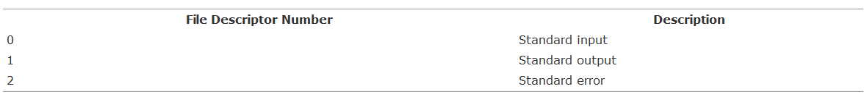
Standard Files
UNIX concept of “standard files”
  standard input (where a command gets its input) - default is the terminal
  standard output (where a command writes it output) - default is the terminal
  standard error (where a command writes error messages) - default is the terminal
Confidential: For Internal Use Only. Copyright © 2011 Accenture. All Rights Reserved.

Slide 29
Redirecting Output
The output of a command may be sent (piped) to a file:
ls -l >output
“>” is used to specify the output file
Confidential: For Internal Use Only. Copyright © 2011 Accenture. All Rights Reserved.

Slide 30
Redirecting Input
The input of a command may come (be piped) from a file:
wc <input
“<” is used to specify the input file
Confidential: For Internal Use Only. Copyright © 2011 Accenture. All Rights Reserved.

Slide 31
Redirecting standard error
Output the standard error to a file
ll xyz 2> abc
“2>” is used to redirect the error to a file
Confidential: For Internal Use Only. Copyright © 2011 Accenture. All Rights Reserved.

Slide 32
Connecting commands with Pipes
The output of one command can become the input of another:
Like CMS Pipes, “|” is used to separate stages
ps aux | grep netscape | wc -l
The output of the ps command is sent to grep
wc takes this input and counts the lines its output going to the console
grep takes input and searches for “netscape” passing these lines to wc
Confidential: For Internal Use Only. Copyright © 2011 Accenture. All Rights Reserved.

Slide 33

Inode
The inode (Index node) is a basic concept related to Unix filesystems. Each and every object/element in the filesystem is associated with an inode.
It store the basic information about a regular file, directory or other filesystem object
Size of each inode entry is 128 bytes
The inode entries store metadata about each object of the filesystem (file or directory) that just points to these structures and does not store any kind of data.
Confidential: For Internal Use Only. Copyright © 2011 Accenture. All Rights Reserved.

Slide 34
Hard link and Soft link
Links – A link is simply a way to refer to the contents of a file. There are two types of links:
Hard Links
  Hard links can be created only within the file system
  Hard links have the same inode number as the original file.
  On deleting the original file, hard linked file can still be accessed.
  Can be created only on files, not on directories.
Soft Links
  Soft Links can be created across file systems.
  Soft link has a different inode number than the original file.
  On deleting the original file, soft link cannot be accessed.
  Can be created on a file or on a directory.
Confidential: For Internal Use Only. Copyright © 2011 Accenture. All Rights Reserved.

Slide 35
Wildcards
Wildcard characters are used as a shortcut to refer to many files. Below are the wildcards are used in Unix.
* - To list all the files that start with
? - Matches only a single character
[] - Matches the range of characters given inside the
square bracket.
Confidential: For Internal Use Only. Copyright © 2011 Accenture. All Rights Reserved.

Slide 36
Command Options
Command options allow you to control a command to a certain degree
Conventions:
  Usually being with a single dash and are a single letter (“-l”)
  Sometimes have double dashes followed by a keyword (“--help”)
  Sometimes follow no pattern at all
Confidential: For Internal Use Only. Copyright © 2011 Accenture. All Rights Reserved.

Slide 37
Common Commands
pwd - print (display) the working directory
cd <dir> - change the current working directory to dir
ls - list the files in the current working directory
ls -l - list the files in the current working directory in long format
Confidential: For Internal Use Only. Copyright © 2011 Accenture. All Rights Reserved.

Slide 38
File Commands
cp <fromfile> <tofile>
  Copy from the <fromfile> to the <tofile>
mv <fromfile> <tofile>
  Move/rename the <fromfile> to the <tofile>
rm <file>
  Remove the file named <file>
mkdir <newdir>
  Make a new directory called <newdir>
rmdir <dir>
  Remove an (empty) directory
Confidential: For Internal Use Only. Copyright © 2011 Accenture. All Rights Reserved.

Slide 39
More Commands
who
  List who is currently logged on to the system
whoami
  Report what user you are logged on as
ps
  List your processes on the system
ps aux
  List all the processes on the system
echo “A string to be echoed”
  Echo a string (or list of arguments) to the terminal
Confidential: For Internal Use Only. Copyright © 2011 Accenture. All Rights Reserved.

Slide 40

Sticky bit on Directory and File
When the sticky bit is set on a directory, only the owner and the root user can delete / rename the files or directories within that directory. other users cannot delete or rename the files (or subdirectories) within that directory.
Once the sticky bit is assigned to a directory, you’ll see (t) as the last character in the permission. In this example, it is drwxrwxrwt.
Confidential: For Internal Use Only. Copyright © 2011 Accenture. All Rights Reserved.

Slide 41
More Commands
alias - used to tailor commands:
  alias erase=rm
  alias grep=”grep -i”
  WC – Word count (The program reads either standard input or a list of files and generates one or more line count, word count, character count.
  -l = Prints the line count
  -c = prints the byte count
  -w = prints the word count
Confidential: For Internal Use Only. Copyright © 2011 Accenture. All Rights Reserved.

Slide 42
More Commands
awk - a file processing language that is well suited to data manipulation and retrieval of information from text files
chown - sets the user ID (UID) to owner for the files and directories named by pathname arguments. This command is useful when from test to production
chown -R apache:httpd /usr/local/apache
Confidential: For Internal Use Only. Copyright © 2011 Accenture. All Rights Reserved.

Slide 43
More Commands
find - Searches a given file hierarchy specified by path, finding files that match the criteria given by expression
Confidential: For Internal Use Only. Copyright © 2011 Accenture. All Rights Reserved.

Slide 44
More Commands
grep - Searches files for one or more pattern arguments. It does plain string, basic regular expression, and extended regular expression searching
grep -i - Used to search for the case insensitive pattern
grep -c - Used to search for matching pattern
grep -v - Used to search for the non-matching pattern
Confidential: For Internal Use Only. Copyright © 2011 Accenture. All Rights Reserved.

Slide 45
More Commands
kill - sends a signal to a process or process group
You can only kill your own processes unless you are root
UID PID PPID C STIME TTY TIME CMD
root 6715 6692 2 14:34 ttyp0 00:00:00 sleep 10h
root 6716 6692 0 14:34 ttyp0 00:00:00 ps -ef
[root@penguinvm log]# kill 6715
[1]+ Terminated sleep 10h
Confidential: For Internal Use Only. Copyright © 2011 Accenture. All Rights Reserved.

Slide 46
More Commands
sed - applies a set of editing subcommands contained in a script to each argument input file
find ./ -name "*.c,v" | sed ’s/,v//g’ | xargs grep "PATH"
This finds all files in the current and subsequent directories with an extension of c,v. sed then strips the ,v off the results of the find command. xargs then uses the results of sed and builds a grep command which searches for occurrences of the word PATH in the C source files.
Confidential: For Internal Use Only. Copyright © 2011 Accenture. All Rights Reserved.

Slide 47
More Commands
tar - manipulates archives
  An archive is a single file that contains the complete contents of a set of other files; an archive preserves the directory hierarchy that contained the original files.
c - Creates a new .tar archive file.
v - Verbosely show the .tar file progress.
f - File name type of the archive file.
x - Untar the file
t - List the content of the tar file
Confidential: For Internal Use Only. Copyright © 2011 Accenture. All Rights Reserved.

Slide 48
Switching Users
su <accountname>
  switch user accounts. You will be prompted for a password. When this command completes, you will be logged into the new account. Type exit to return to the previous account
su
  Switch to the root user account. Do not do this lightly
Note: The root user does not need to enter a password when switching users. It may become any user desired. This is part of the power of the root account.
Confidential: For Internal Use Only. Copyright © 2011 Accenture. All Rights Reserved.

Slide 49
File Permissions
Every file
  Is owned by someone
  Belongs to a group
  Has certain access permissions for owner, group, and others
  Default permissions determined by umask
Confidential: For Internal Use Only. Copyright © 2011 Accenture. All Rights Reserved.

Slide 50
File Permissions
Every user:
  Has a uid (login name), gid (login group) and membership of a "groups" list:
    The uid is who you are (name and number)
    The gid is your initial “login group” you normally belong to
    The groups list is the file groups you can access via group permissions
Confidential: For Internal Use Only. Copyright © 2011 Accenture. All Rights Reserved.

Slide 51
File Permissions
Unix provides three kinds of permissions:
  Read - users with read permission may read the file or list the directory
  Write - users with write permission may write to the file or new files to the directory
  Execute - users with execute permission may execute the file or lookup a specific file within a directory
Confidential: For Internal Use Only. Copyright © 2011 Accenture. All Rights Reserved.

Slide 52
File Permissions
The long version of a file listing (ls -l) will display the file permissions:
-rwxrwxr-x 1 rvdheij rvdheij 5224 Dec 30 03:22 hello
-rw-rw-r-- 1 rvdheij rvdheij 221 Dec 30 03:59 hello.c
-rw-rw-r-- 1 rvdheij rvdheij 1514 Dec 30 03:59 hello.s
drwxrwxr-x 7 rvdheij rvdheij 1024 Dec 31 14:52 posixuft
Permissions
Group
Owner
Confidential: For Internal Use Only. Copyright © 2011 Accenture. All Rights Reserved.

Slide 53
Interpreting File Permissions
-rwxrwxrwx
Other permissions
Group permissions
Owner permissions
Directory flag (d=directory; l=link)
Confidential: For Internal Use Only. Copyright © 2011 Accenture. All Rights Reserved.

Slide 54
Changing File Permissions
Use the chmod command to change file permissions
  The permissions are encoded as an octal number
  You can change the default setting of the files or directories by declaring the umask
chmod 755 file # Owner=rwx Group=r-x Other=r-x
chmod 500 file2 # Owner=r-x Group=--- Other=---
chmod 644 file3 # Owner=rw- Group=r-- Other=r--
chmod +x file # Add execute permission to file for all
chmod o-r file # Remove read permission for others
chmod a+w file # Add write permission for everyone
Confidential: For Internal Use Only. Copyright © 2011 Accenture. All Rights Reserved.

Slide 55
Vi Editor
vi editor to edit an existing file or to create a new file from scratch. You can also use this editor to just read a text file
Operation mode
Command mode − This mode enables you to perform administrative tasks such as saving files, executing commands, moving the cursor, cutting (yanking) and pasting lines or words, and finding and replacing. In this mode, whatever you type is interpreted as a command.
Insert mode − This mode enables you to insert text into the file. Everything that's typed in this mode is interpreted as input and finally it is put in the file .
Confidential: For Internal Use Only. Copyright © 2011 Accenture. All Rights Reserved.

Slide 56
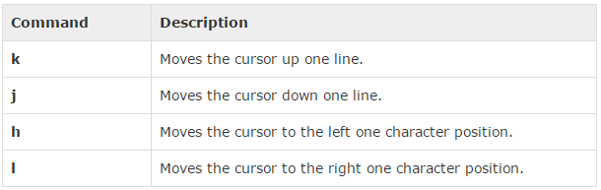
Vi Editor – Moving within a file
To move around within a file without affecting your text, you must be in command mode (press Esc twice). Here are some of the commands you can use to move around one character at a time
Confidential: For Internal Use Only. Copyright © 2011 Accenture. All Rights Reserved.

Slide 57
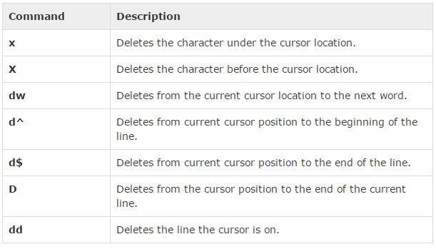
Deleting Characters
List of important commands which can be used to delete characters and lines in an opened file.
Confidential: For Internal Use Only. Copyright © 2011 Accenture. All Rights Reserved.

Slide 58
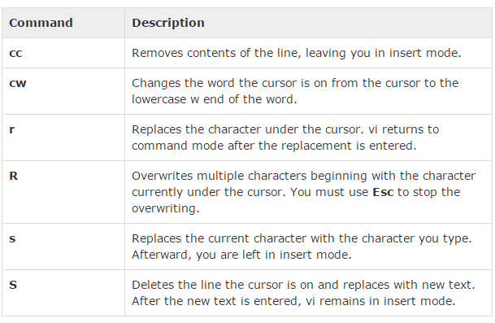
Change commands
We have the capability to change characters, words or lines in vi without deleting them.
Confidential: For Internal Use Only. Copyright © 2011 Accenture. All Rights Reserved.

Slide 59
Processes
Processes are created in a hierarchical structure whose depth is limited only by the virtual memory available to the virtual machine
A process may control the execution of any of its descendants by suspending or resuming it, altering its relative priority, or even terminating it
Termination of a process by default causes termination of all its descendants; termination of the root process causes termination of the session
Unix assigns a process ID (PID) to the process
Confidential: For Internal Use Only. Copyright © 2011 Accenture. All Rights Reserved.

Slide 60
Processes
Foreground
  When a command is executed from the prompt and runs to completion at which time the prompt returns is said to run in the foreground
Background
  When a command is executed from the prompt with the token “&” at the end of the command line, the prompt immediately returns while the command continues is said to run in the background
Confidential: For Internal Use Only. Copyright © 2011 Accenture. All Rights Reserved.

Slide 61
Processes
Daemons
  Background processes for system administration are referred to as “daemons”
  These processes are usually started during the boot process
  The processes are not assigned any terminals
UID PID PPID C STIME TTY TIME CMD
root 5 1 0 1999 ? 00:00:14 [kswapd]
bin 254 1 0 1999 ? 00:00:00 [portmap]
root 307 1 0 1999 ? 00:00:23 syslogd -m 0
root 350 1 0 1999 ? 00:00:34 httpd
Confidential: For Internal Use Only. Copyright © 2011 Accenture. All Rights Reserved.

Slide 62
Processes
& causes process to be run in “background”
[root@penguinvm log]# sleep 10h &
[1] 6718
[root@penguinvm log]# ps -ef
UID PID PPID C STIME TTY TIME CMD
root 6718 6692 0 14:49 ttyp0 00:00:00 sleep 10h
Job Number
Process ID (ID)
Parent Process ID
Confidential: For Internal Use Only. Copyright © 2011 Accenture. All Rights Reserved.

Slide 63
Processes - PID
PID
  A process ID is a unique identifier assigned to a process while it runs
  Each time you run a process, it has a different PID (it takes a long time for a PID to be reused by the system)
  You can use the PID to track the status of a process with the ps command or the jobs command, or to end a process with the kill command
Confidential: For Internal Use Only. Copyright © 2011 Accenture. All Rights Reserved.

Slide 64
Processes - PPID
PPID
  A process that creates a new process is called a parent process; the new process is called a child process
  The parent process (PPID) becomes associated with the new child process when it is created
  The PPID is not used for job control
Confidential: For Internal Use Only. Copyright © 2011 Accenture. All Rights Reserved.

Slide 65
Questions
?
Confidential: For Internal Use Only. Copyright © 2011 Accenture. All Rights Reserved.

Slide 66
Thank You
Confidential: For Internal Use Only. Copyright © 2011 Accenture. All Rights Reserved.

